Slide 1
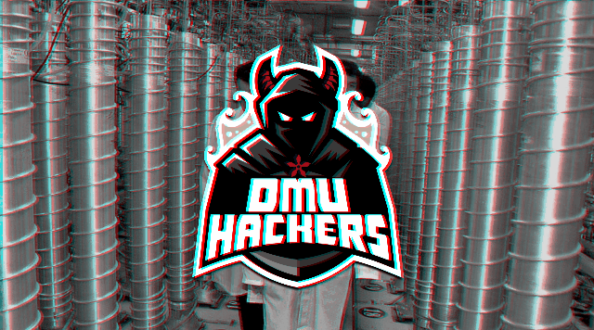

Slide 2
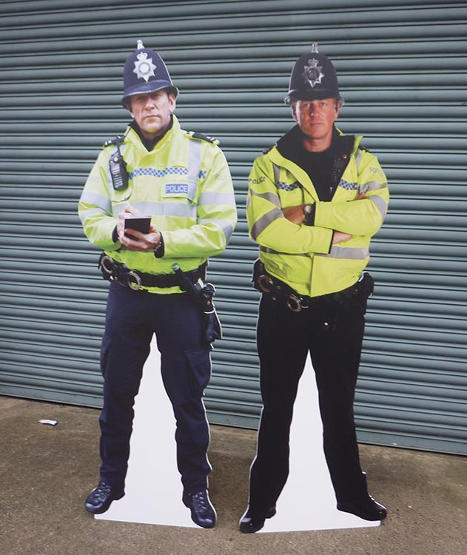



Disclaimer
Don’t do illegal shit

Slide 3

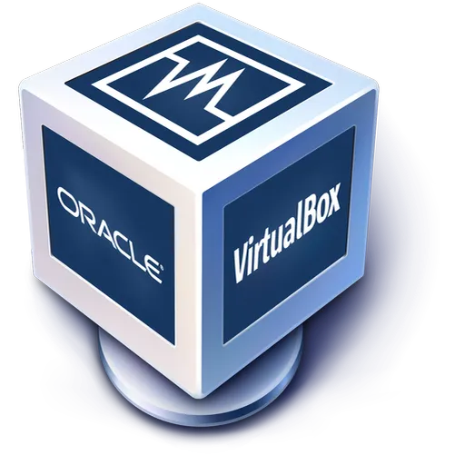
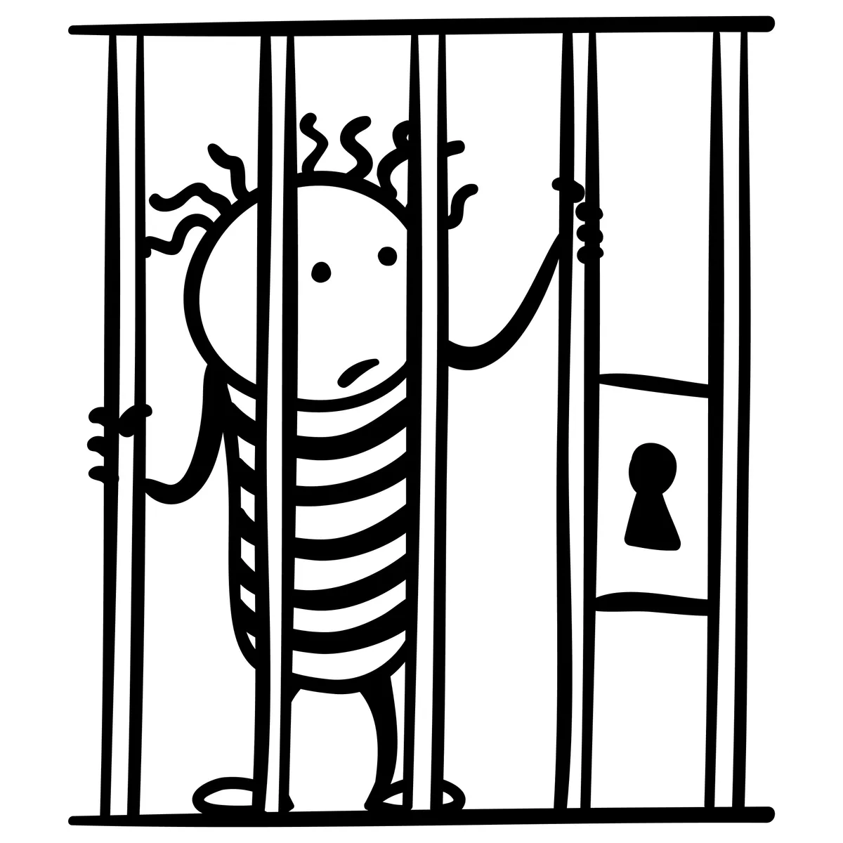
Container Escapes

Slide 4
Containers
(what are they?)
A container is a virtualized environment run on a host machine. They are designed to package and isolate a service into 1 environment.
Essentially a container will contain all the programs and libraries it needs to run and separate itself from the host.
This allows you to run multiple machines and services off 1 machine without the need to cram all the files needed for each service into 1 environment
An example would be to run a webserver
Ideally your webserver should not be vulnerable to RCE
But to be extra secure you can run it inside a container.
This way when a hacker does get in, they are restricted by the bounds of the web server
Preventing them from moving through your network…
(or at least that's the plan)

Slide 5
Chroot Jails
(what are they?)
Probably the most basic form of a container.
It changes the root of the filesystem to that of the new directory you've chosen.
Any services or programs from reading up.
Created by copying or linking all needed files, libraries, programs etc into a new directory and starting the program with the new folder as the root

Slide 6
Docker
(what is it?)
Docker is one of the most popular containerisation systems that you will see in the wild (or atleast on ctfs)
Docker allows you to create images which can be deployed easily.
They are more advanced than Chroot jails and will simulate operating system software

Slide 7
Virtual Machines
(you, hopefully, already know)
A virtualized space where you can run entire operating systems on top of your current one. Which also simulates hardware as though it were a real computer.
It’s not sharing a filesystem with the host at all (unless you add shared folders)
A vms file system is inside of a virtual hard drive file.
Used for
simulating the use of an operating system
Testing out an operating system before installing to bare metal
When isolating a service isnt enough and you need the use of a whole OS
Our kali machines are a great example of this.
If a connection gets reversed, and your virtual network is NAT there’s not a lot the attacker can do.

Slide 8
And there are others
kubernetes
Ansible
Proxmox
etc

Slide 9
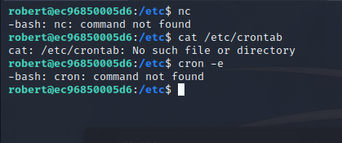
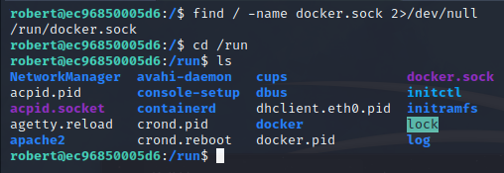
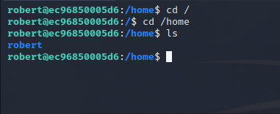
Enumerating a Container
How do you know you are in a container?
This can be seen through various factors.
Often containers will contain very little content
Containers are designed to do 1 thing at a time
Done right, they will only have what they need
They will likely have
Little to no user accounts
Small list of binaries to use
Not a lot of libraries
How do you know what type?
Docker containers will contain a docker.sock file often in `/` or `/run` but can also be somewhere else
Virtual machines will have a lot of Vm files in tmp or other directories

Slide 10

Time to escape

Slide 11
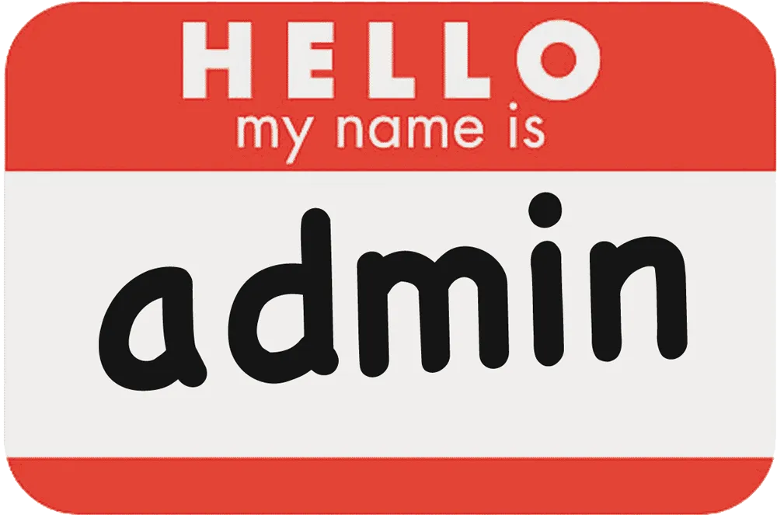
The #1 Way Attackers Escape
The admins simply configured it wrong.
The admins forgot
To remove important files
To unmount important filesystems
To close a local connection

Slide 12

The Other Ways Attackers Escape
Privilege escalation to root within the container will make life a lot easier to manipulate the system
Out of date software within the container itself
The host may be updated often, but if the admin does not update the container, then it could be using out of date software
An exploit with the container system itself
This is much rarer, but its been known to happen

Slide 13
Important Files
Files you should ABSOLUTELY look for within a container
ssh keys
Commonly named id_rsa but can be named differently
Commonly stored in a users .ssh folder but can be elsewhere
Quick and dirty searches
find / -name “id_rsa” 2>/dev/null
grep -R OPENSSH 2>/dev/null
Docker and Docker.sock
A docker binary inside the container with access to the sock file can be used to connect directly to the host

Slide 14
Important Files
Files you should ABSOLUTELY look for within a container
Anything holding credentials
This might be as simple as “passwords.txt”
But could also be hidden in the applications source code
Sql databases within the container
etc

Slide 15
Filesystems
Mounted file systems will often be in /media or /mnt. But they might be somewhere else. Mounted file systems from the host can be interacted with.
Sometimes your permissions inside the container carry over to this filesystem
Root inside the container can equal root perms on the filesystem.
This won’t execute the commands on the host
But you can read, make and modify files, including executables

Slide 16
Connections
Anything with connections
Containers may have connections to the host that aren’t ported out remotely
You may be able to interface with the host through localhost connections
ssh may be available
ftp might be available
sql might be available
etc
Try using these services with usernames and passwords you've already found
A good way to check for these is with netstat, ss.
Or for a port view your more familiar with - putting a static binary of nmap onto the machine or in the container will allow you to run it on the localhost

Slide 17

Honourable Mentions
Escaping from the container isn’t the whole story
Once you've escaped, you will likely once again privesc the host
Sometimes the container is the key to this
If
you have root inside a container
that container has a mounted file system
The root may not be ‘squashed’
This means you can manipulate or at least read the host filesystem as though you are root
Creating a Bash SUID to run in the host is a good way to privesc

Slide 18
Practical
https://tryhackme.com/room/linuxagency
We’re going to skip to the good bit
Maya is a user on the machines host.
SSH in as maya
Username: maya
Password: maya{a66e159374b98f64f89f7c8d458ebb2b}
The next user up is robert and accessing his account will place you into a container.
Using the container you need to escalate to root of the host machine.

Slide 19
Hints
You might need to crack the passphrase on the ssh key
The Normal ssh port wont work here, see if you can find another one
Is sudo the right version?
After root:
Is there a docker binary inside the container? How could you use this
https://book.hacktricks.xyz/linux-hardening/privilege-escalation/docker-breakout/docker-breakout-privilege-escalation

